Slide 1
Neural exosomes enhance angiogenesis in vitro as determined by automated image analysis
Austin Passaro

Slide 2
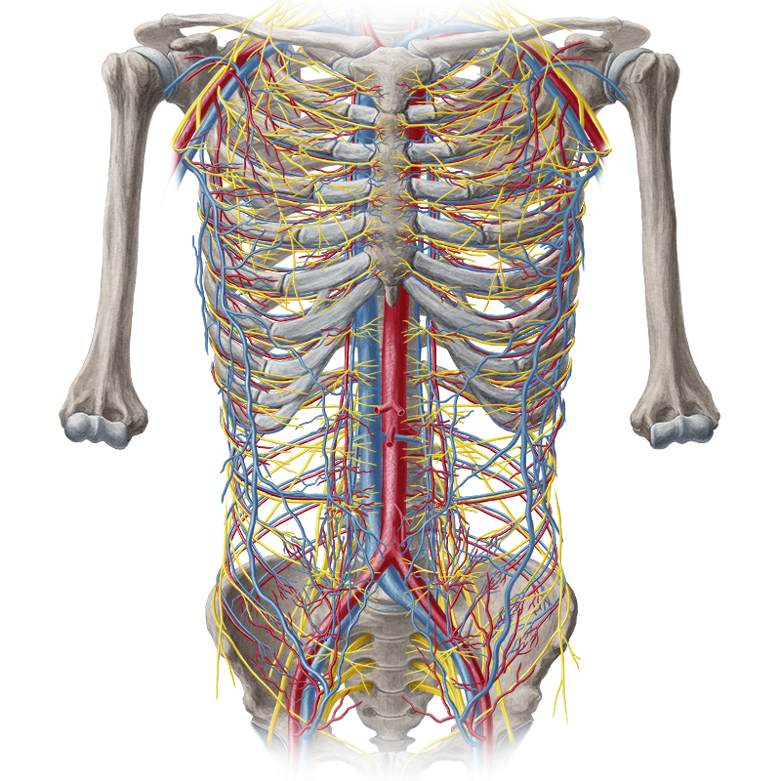
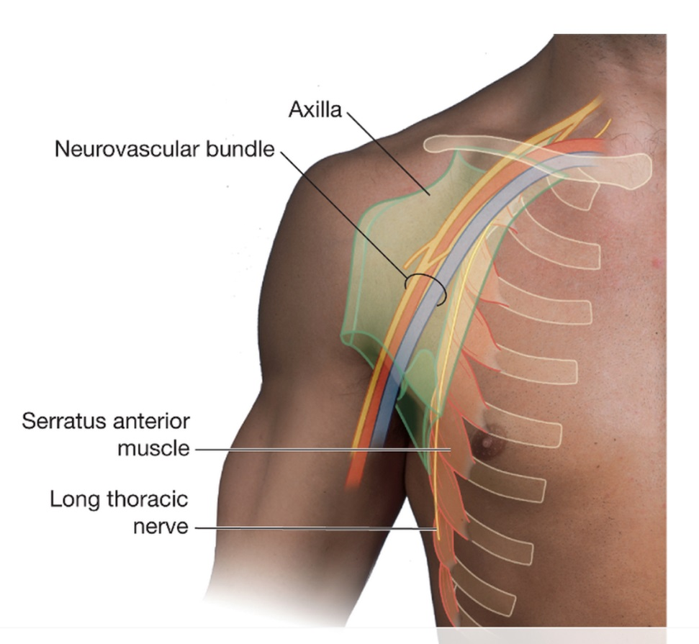
Neurovasculature
https://web.duke.edu/anatomy/Lab10/Lab11_preLab.html
https://www.kenhub.com/en/start/c/first-look-at-neurovasculature
Notes:
Nervous system generally thought of as a communication system between and within tissues
Circulatory/vascular system generally thought of for oxygen and nutrient delivery to tissues
Two closely interconnected, initially noticed spatially with neurovascular bundles, but also functionally (BBB, neural stem cell niche, neurovascular coupling/hemodynamic response)
2

Slide 3

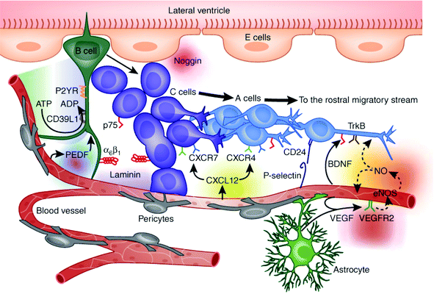
Neurovascular interactions in the neural stem cell niche
Putnam (2014). Biomater. Sci., 2014,2, 1562-1573
Notes:
Substantial interactions take place among the various cell types that comprise the neurovasculature, through both juxtacrine and paracrine signaling
For example, the vascular system has an important role in regulating the neural stem cell niche through complex signaling and growth factor secretion/distribution
3

Slide 4
Applications and Relevance
Clinical
Bioengineering
Cancer
Stroke
Autism
ALS
Alzheimer’s disease
Parkinson’s disease
Diabetic neuropathy
Nerve regeneration
Tissue engineering
Cellular machines
“Organ on a chip” technology
Improved in vitro assays and cell culture systems

Slide 5
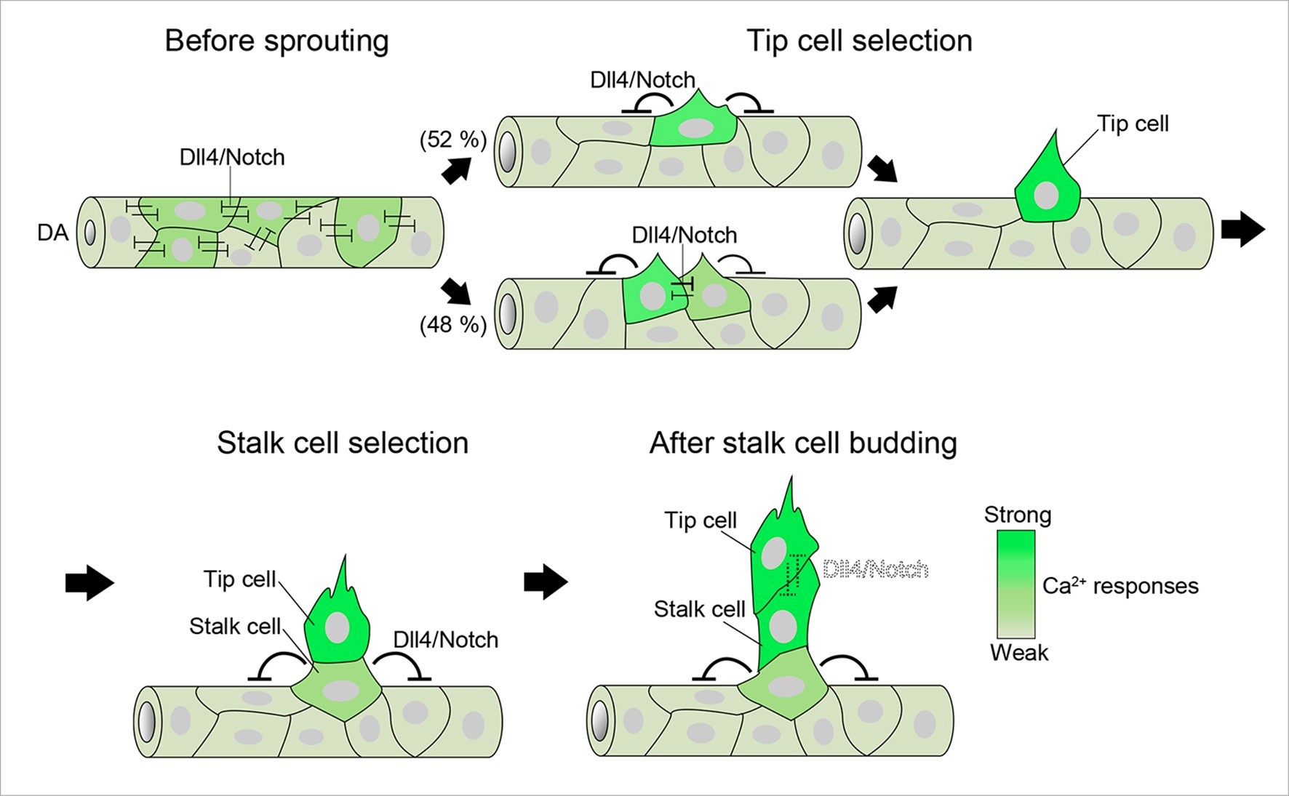
Angiogenesis
Yokota et al. (2015). eLife 2015;4:e08817

Slide 6
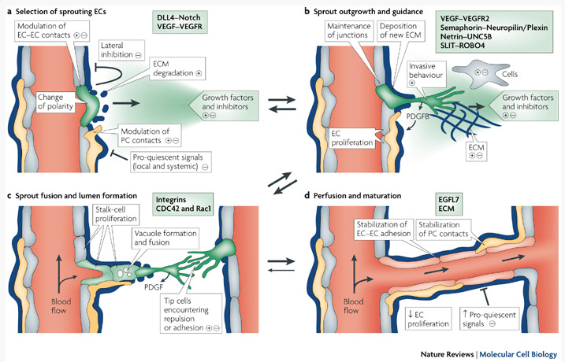
Angiogenesis
http://dxline.info/diseases/angiogenesis

Slide 7
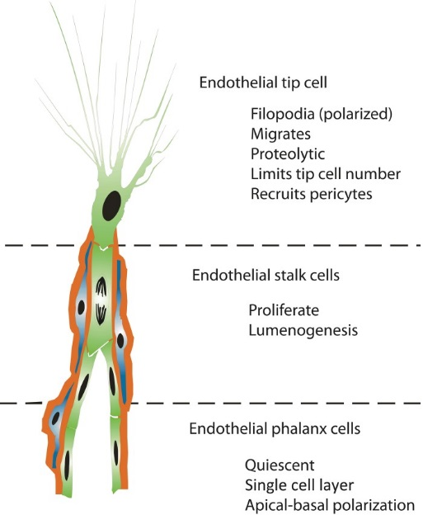
Endothelial cell subphenotypes
Siemerink et al. 2013

Slide 8
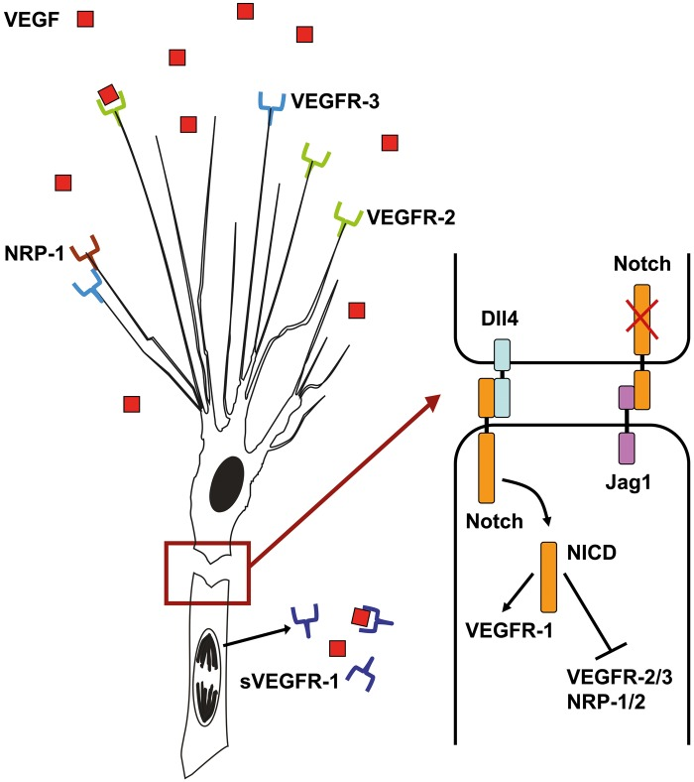
VEGF-VEGFR2-Dll4-Notch pathway
Siemerink et al. 2013

Slide 9
VEGF-VEGFR2-Dll4-Notch pathway
Siemerink et al. 2013

Slide 10
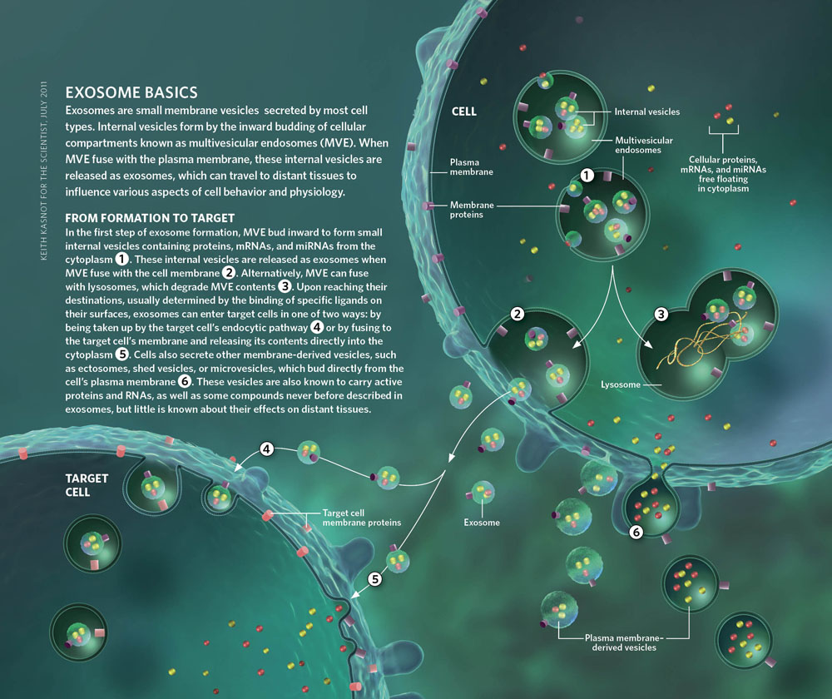
Exosomes
http://www.the-scientist.com/?articles.view/articleNo/30793/title/Exosome-Explosion/
Notes:
Small vesicles (~30-150nm) secreted by most cell types from multi-vesicular bodies
Originally thought to contain waste, but more recently shown to be important in intercellular communication
Contain protein and RNA (especially mRNA and miRNA) that can be transferred to target cells
10

Slide 11
Objective
Given:
Evidence that Dll4 can be incorporated into exosomes and is highly expressed by neural progenitors
Evidence that neuroblastic (PC12) exosomes contain pro-angiogenic miRNAs
Determine the effect of neural progenitor exosomes (NPEX) on angiogenesis using a three-dimensional microfluidic culture system

Slide 12
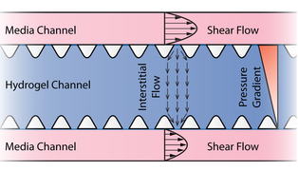
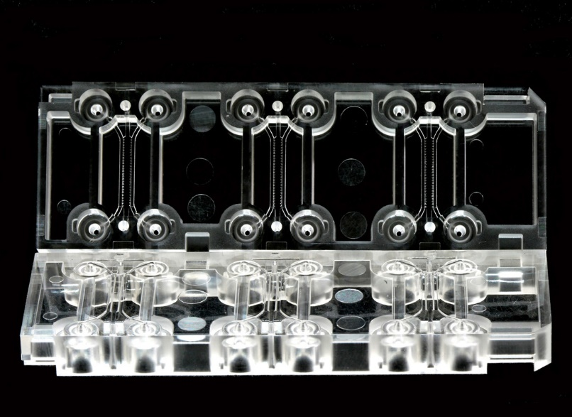
Microfluidic device
AIM Biotech

Slide 13
Angiogenesis assay
Exosomes
Collagen
Endothelial
cells
(in fibronectin)
AIM Biotech

Slide 14
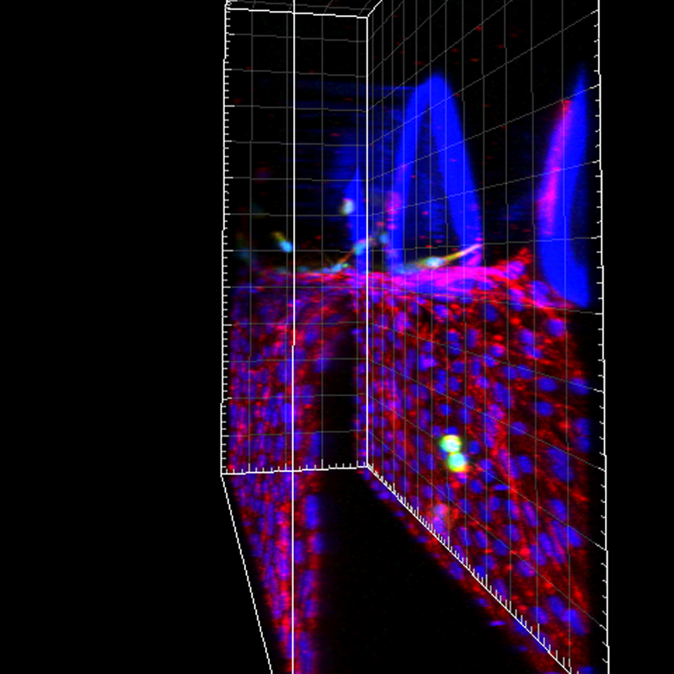
Angiogenesis assay
AIM Biotech

Slide 15
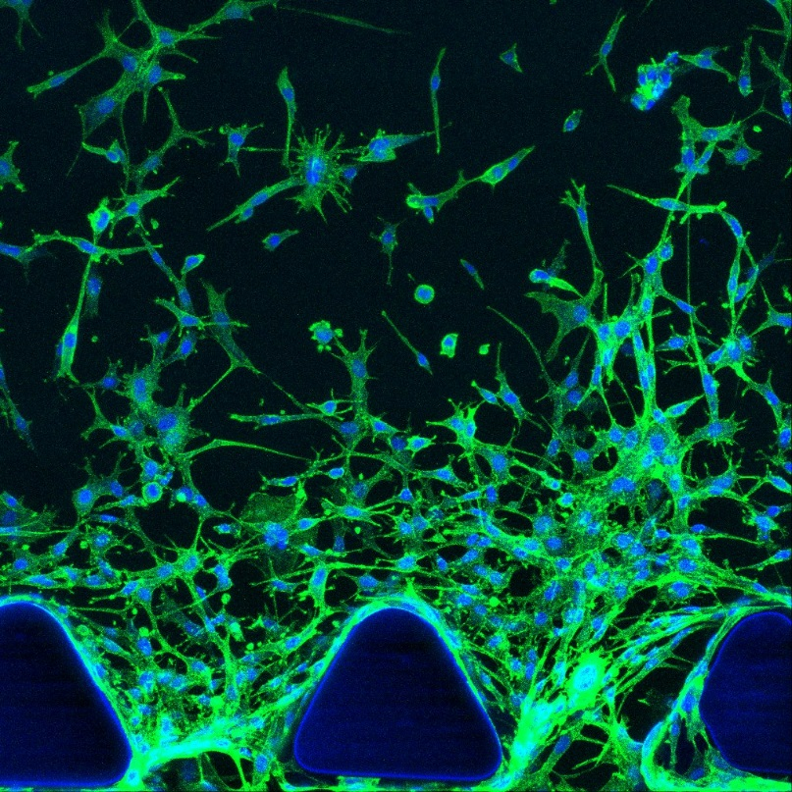
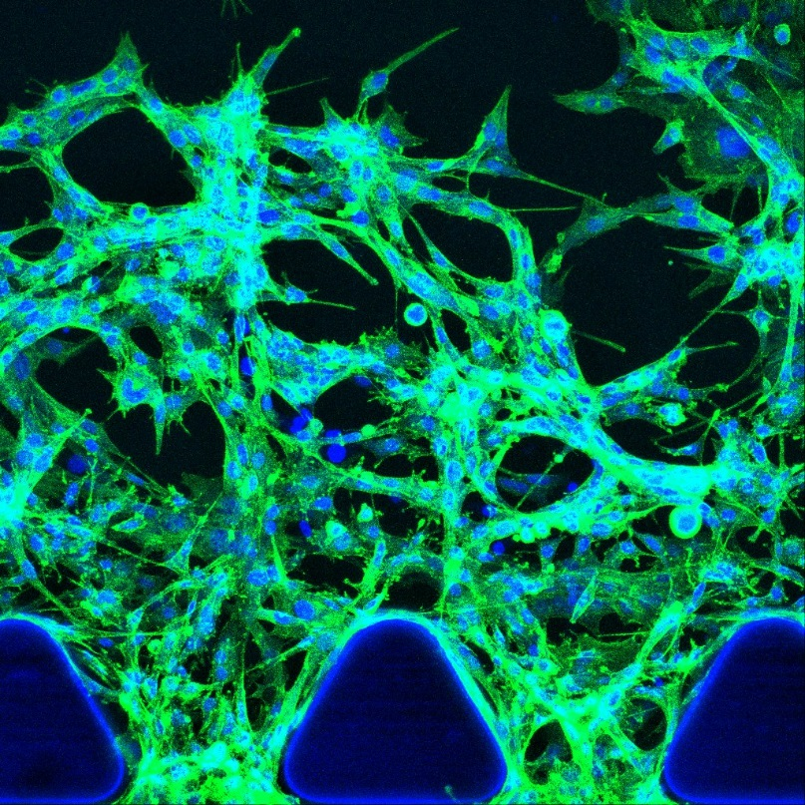
NPEX treatment enhances angiogenesis
NPEX
Control
Control
NPEX

Slide 16
Analysis Approach
Count cells in gel region
Calculate skeletonized length in gel region
Calculate total cell area in the gel region

Slide 17
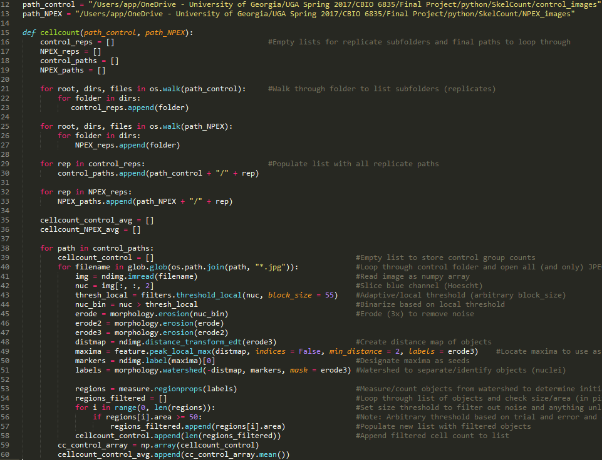

Slide 18
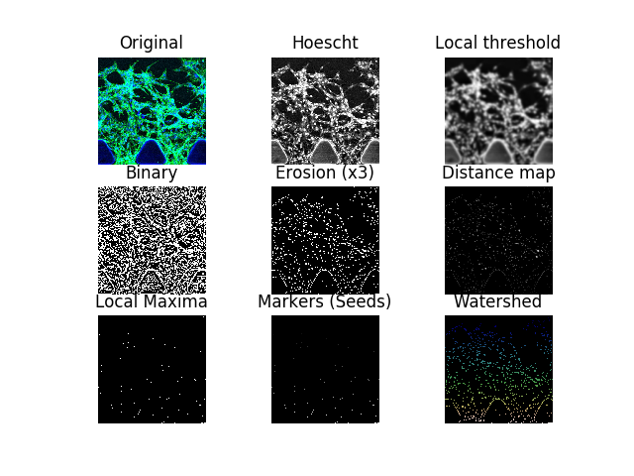

Slide 19
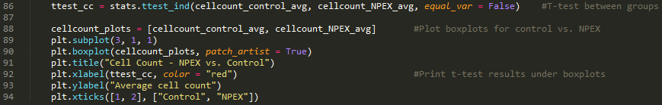
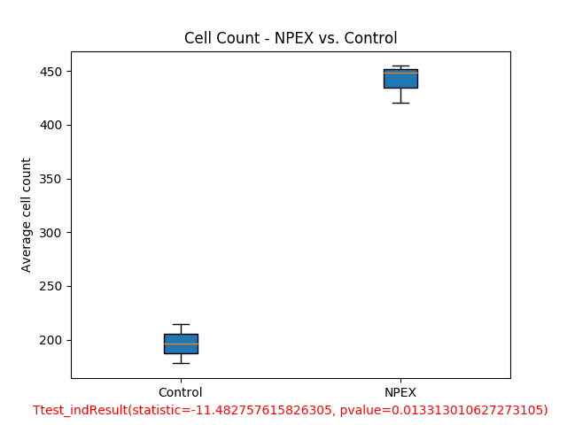

Slide 20
Analysis Approach
Count cells in gel region
Calculate skeletonized length in gel region
Calculate total cell area in the gel region

Slide 21
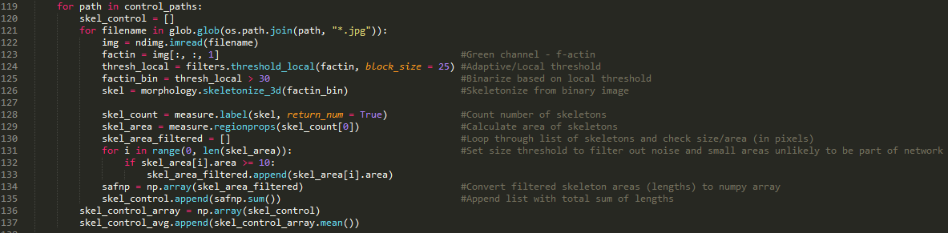

Slide 22
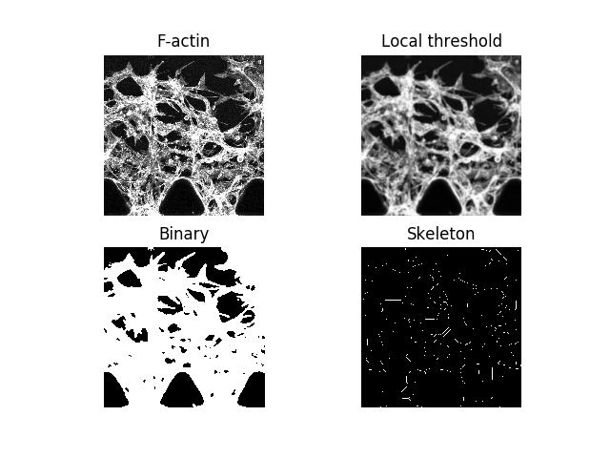

Slide 23
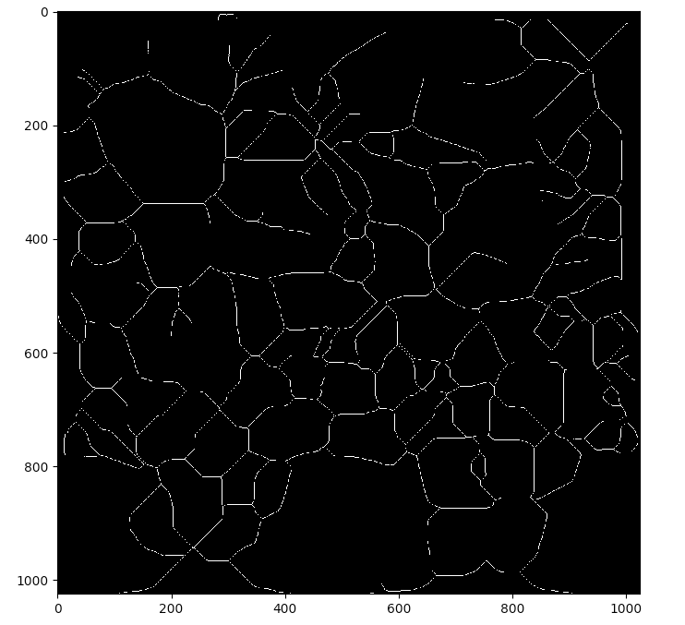

Slide 24
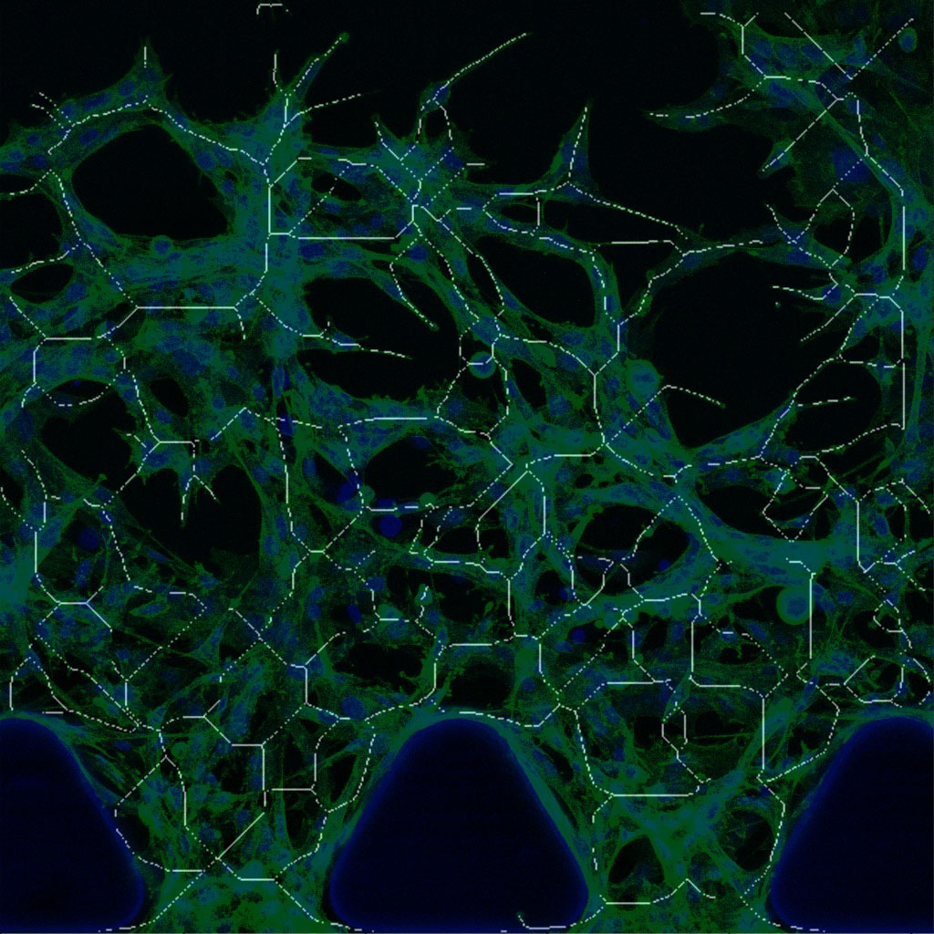

Slide 25
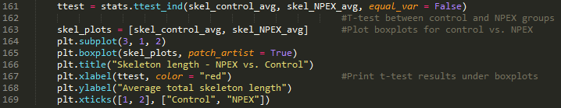
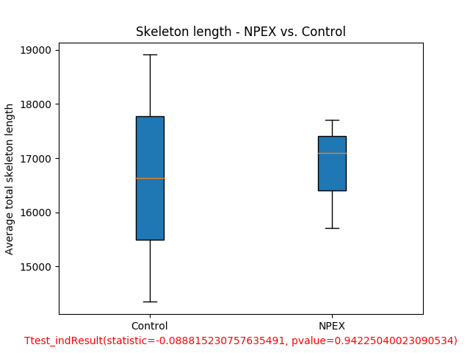

Slide 26
Analysis Approach
Count cells in gel region
Calculate skeletonized length in gel region
Calculate total cell area in the gel region

Slide 27
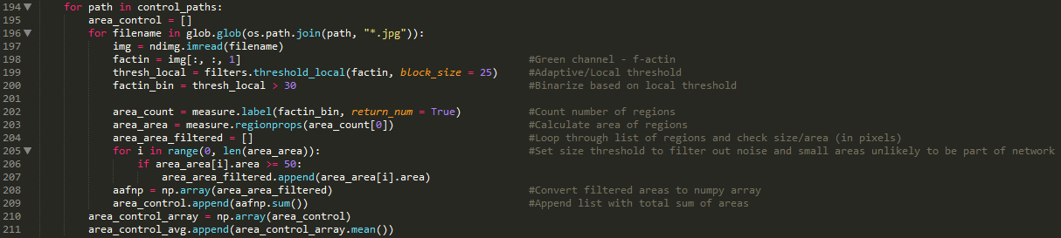

Slide 28
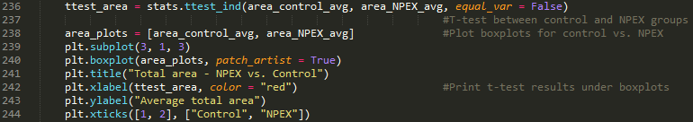
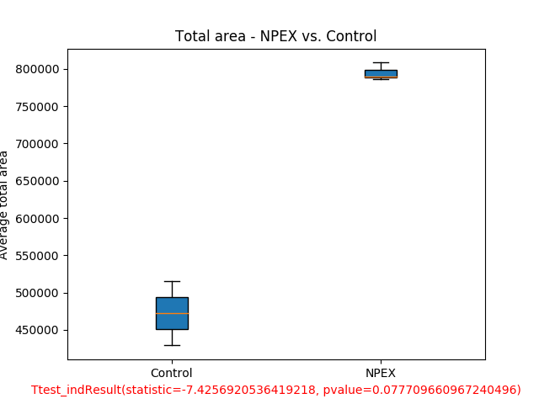

Slide 29
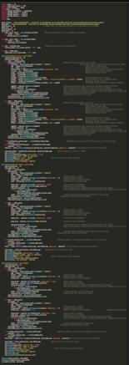
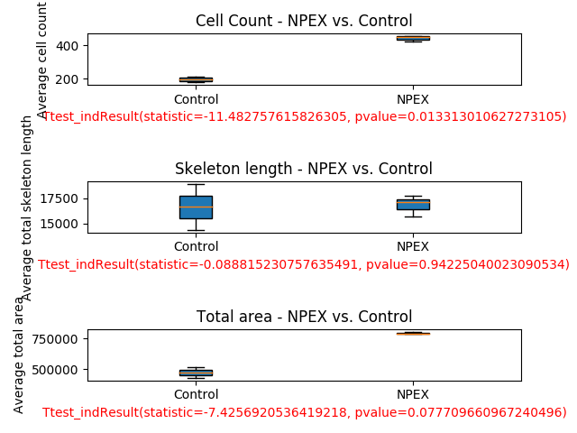
Summary

Slide 30
Conclusions
NPEX treatment appears to enhance cell migration and/or proliferation
As evident by increased cell count and total cell area in gel region
Mechanism hypothesized to be via Dll4 or pro-angiogenic miRNAs contained in NPEX
Additional experiments required to determine whether or not this activity is truly indicative of angiogenesis

Slide 31




Acknowledgments
Stice lab
RBC
ArunA Biomedical
EBICS
Dr. Kamm, MIT
Dr. McCloskey, UC Merced

